Slide 1
Camera Geometry
Camera Projections, Camera Calibration, Camera Pose Estimation
Computer Vision, 6th Semester, 2024

Slide 2
Camera Projections

Slide 3
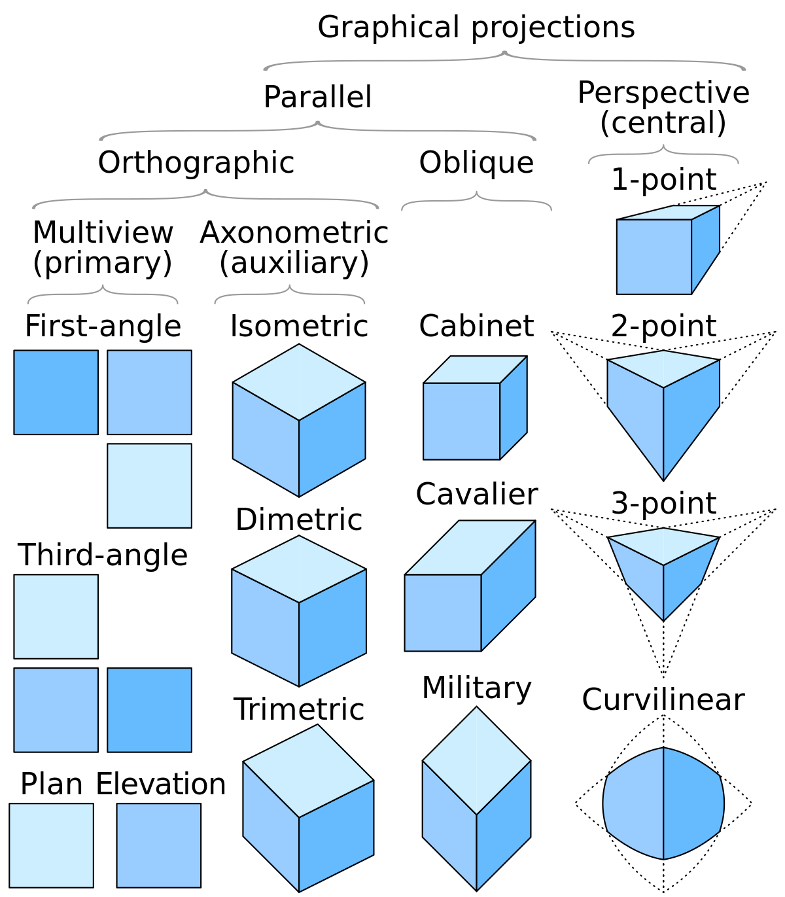
3D Projections
Focus on:
Perspective Projection
1-point
2-point
Orthographic Projection
Isometric

Slide 4
Concept of Camera Projections
Camera projections describe how a 3D scene is projected onto a 2D image or screen
There are different types of camera projections, but two common ones are:
Perspective projection
Orthographic projection
Understanding these projections is crucial for tasks like:
Rendering 3D scenes into 2D images
Augmented reality
Computer vision applications:
Object recognition and tracking

Slide 5
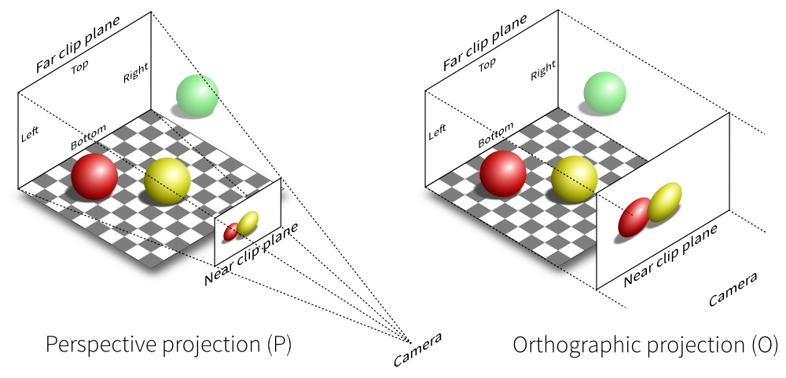
Camera Projections

Slide 6
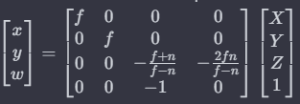
Perspective Projection
Mimics the way our eyes perceive depth in the real world.
Objects farther away appear smaller.
Parallel lines seem to converge at a vanishing point.
A 3D point (X, Y, Z) in the world is projected onto a 2D image plane using a perspective transformation.
The transformation can be represented mathematically as:
Where:
(x, y) are the coordinates of the projected point on the image plane.
(X, Y, Z) are the coordinates of the 3D point in the world.
f is the focal length of the camera.
n is the distance to the near clipping plane.

Slide 7
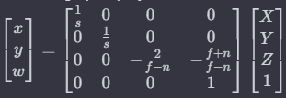
Orthographic Projection
Simpler form:
Parallel lines remain parallel
There is no depth perception.
Often used in:
Technical drawings
Cases of priority of object size over object depth
The orthographic projection transformation can be represented as:
Where:
(x, y) are the coordinates of the projected point on the image plane.
(X, Y, Z) are the coordinates of the 3D point in the world.
s is a scaling factor.
f and n are the distances to the far and near clipping planes, respectively.

Slide 8
Camera Projection Matrix
Also known as the camera matrix or perspective matrix
4x4 matrix used in computer graphics and computer vision to perform perspective projection.
Used to transform 3D coordinates of points in a virtual camera space to 2D coordinates on the image plane.
Combines the effects of translation, rotation, and perspective projection.

Slide 9



Camera Projection Matrix
‘P’: camera projection matrix.
‘K’: camera intrinsic matrix (containing information about the camera's focal length, principal point, and pixel aspect ratio).
‘R’: rotation matrix representing the orientation of the camera in the world.
‘t’: translation vector representing the position of the camera in the world.
‘fx’, ‘fy’: focal lengths along x and y axes
‘cx’, ‘cy’: coordinates of the principal point (the center of the image)

Slide 10
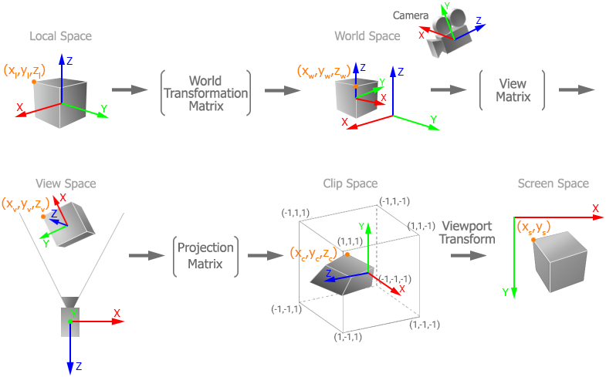
Rendering a Point from 3D to 2D

Slide 11
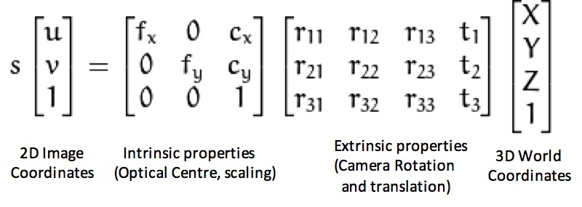
Rendering a Point from 3D to 2D

Slide 12
Camera Calibration

Slide 13
Concept
Involves determining the intrinsic and extrinsic parameters of a camera.
This information is essential for accurately mapping the 3D world onto a 2D image captured by the camera.
Particularly important in applications like:
Robotics
Augmented reality
3D reconstruction
To ensure accurate parameter estimation, camera calibration should be performed:
Under various conditions
At different distances
At different angles
With respect to changed camera setup/hardware

Slide 14
Key Concepts of Camera Calibration
Intrinsic Parameters:
Focal Length (f): Distance between the camera's optical center and the image plane (usually expressed in pixels)
Principal Point (c): The point where the optical axis intersects the image plane (also expressed in pixel coordinates)
Extrinsic Parameters:
Rotation Matrix (R) and Translation Vector (t): The position and orientation of the camera in the world coordinate system.
Distortion Parameters:
Radial Distortion (k1, k2, k3): Occurs when light rays bend more at the outer edges of the lens than at the center.
Tangential Distortion (p1, p2): Occurs when the lens is not perfectly parallel to the image plane.
Calibration Process:
Chessboard or Calibration Pattern: Capturing images of a known calibration pattern from different angles and distances.
Image Points and World Points: Identify corresponding points in the 2D image and their 3D coordinates in the real world.
Camera Matrix (K) and Distortion Coefficients (D): Use these corresponding points to compute the intrinsic and distortion parameters.

Slide 15
Lens Distortion
Common phenomenon in cameras
Affects the accuracy of imaging systems
Occurs because camera lenses do not perfectly replicate the ideal pinhole camera model
Two main types of lens distortion:
Radial distortion
Tangential distortion

Slide 16
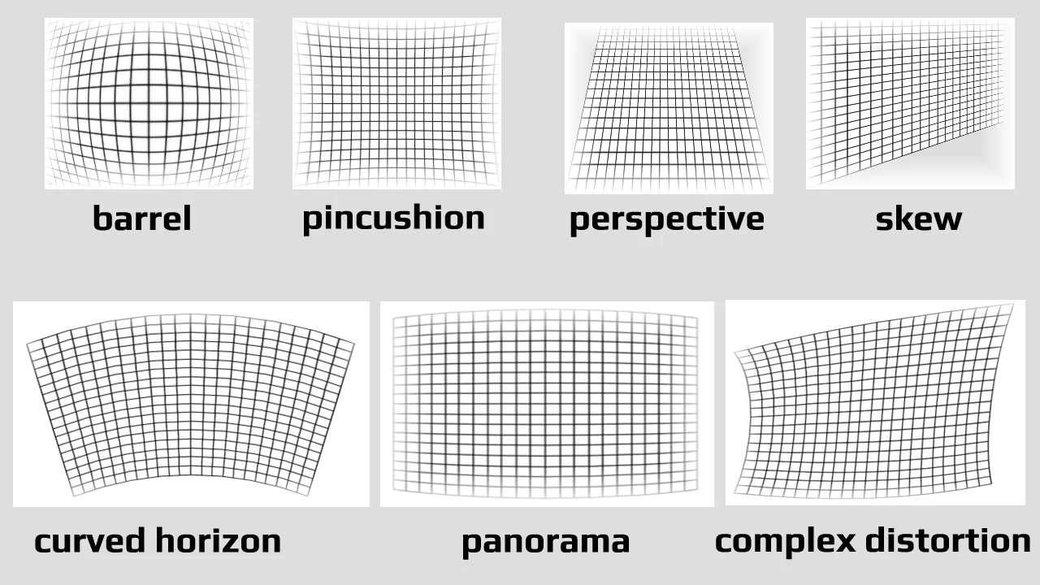
Types of Lens Distortion

Slide 17
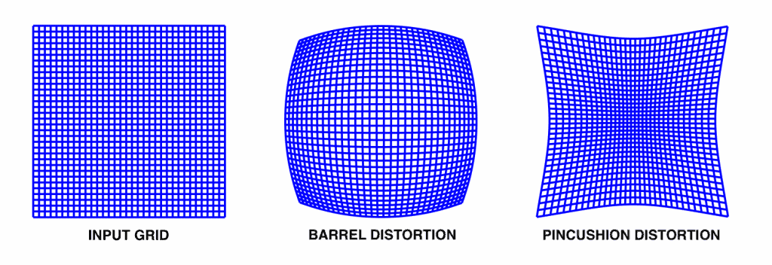
Radial Distortion
Barrel Distortion:
Straight lines appear curved outward towards the edges of the image.
Common in wide-angle lenses.
Pincushion Distortion:
Straight lines appear curved inward towards the center of the image.
More typical in telephoto lenses.
Radial distortion is primarily caused by imperfections in the lens shape:
Result – light rays bending more at edges than at center

Slide 18
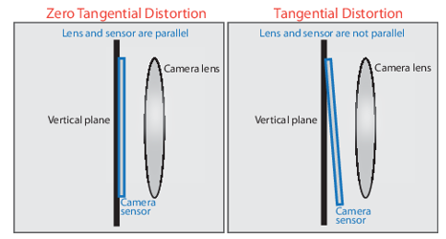
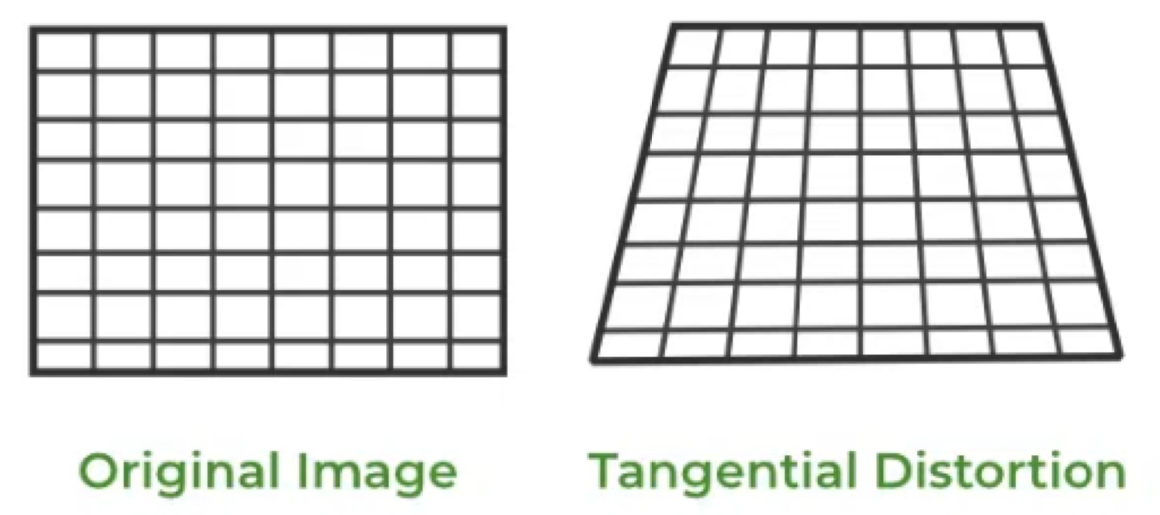
Tangential Distortion
Occurs when the lens is not perfectly aligned parallel to the image plane.
Causes straight lines to appear tilted.
Often caused by slight misalignments in the lens components during manufacturing or assembly.

Slide 19
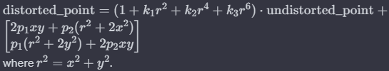
Distortion Correction
k1, k2, k3: Radial Distortion coefficients.
p1, p2: Tangential Distortion coefficients.
x, y: Coordinates of distorted point.
Undistorted point is reverse calculated.

Slide 20
Camera Pose Estimation

Slide 21
Concept
Involves determining the position and orientation of a camera in a given scene.
Goal:
Compute the camera's translation and rotation with respect to a reference coordinate system.
Crucial step in many applications:
Augmented reality
Robotics
3D reconstruction

Slide 22
Key Aspects
Camera model and geometry
Pinhole, Thin-lens, Fisheye, Spherical, Stereo, etc.
Pose attributes
Translation (Position):
Position of the camera in 3D space
Usually represented by a vector [tx, ty, tz]
Rotation (Orientation):
Orientation of the camera
Common representations: Euler angles, rotation matrices, or quaternions.
Type of estimation
2D-to-3D Correspondences:
Requires known 3D points and their corresponding 2D projections in the image.
Methods like PnP (Perspective-n-Point) can be used to estimate camera pose based on these correspondences.
Structure from Motion (SfM):
Involves reconstructing a 3D scene from a sequence of 2D images.
SfM techniques estimate both camera poses and 3D structure simultaneously.
Visual Odometry:
Estimates camera motion by tracking features across consecutive frames.
Deep Learning Approaches:
Utilize neural networks to directly predict camera poses from images.

Slide 23
Camera Models
Pinhole Camera Model
Thin Lens Camera Model
Fish-Eye Camera Model
Omni-Directional Camera Model
Spherical Camera Model
Dual-Fisheye Camera Model
Panoramic Camera Model
Multi-View Camera Model
Stereo Camera Model
RGB-D Camera Model
Time-of-Flight Camera Model
Used to:
Represent the imaging process
Capture the relationship between the 3D world and the 2D image formed by a camera

Slide 24
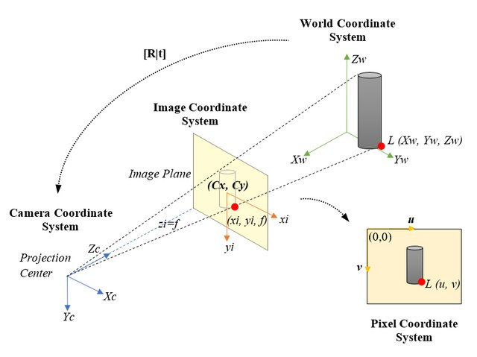
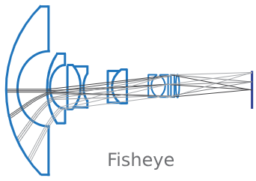
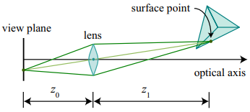
Camera Models
Pin-hole model
Thin Lens model
Fish-Eye model
It assumes that light rays enter the camera through a single point (the pinhole) and project onto an image plane.
It extends the pinhole camera model by incorporating a thin lens.
It considers the lens's focal length and accounts for lens distortion effects.
It has a wide field of view.
The images exhibit significant distortion.

Slide 25
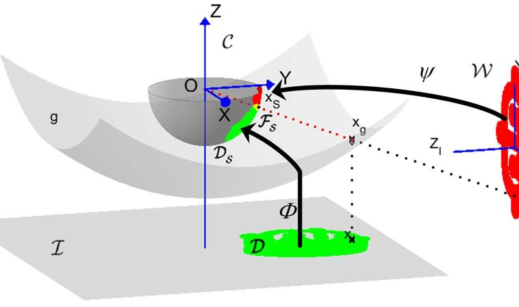
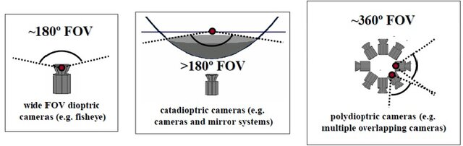
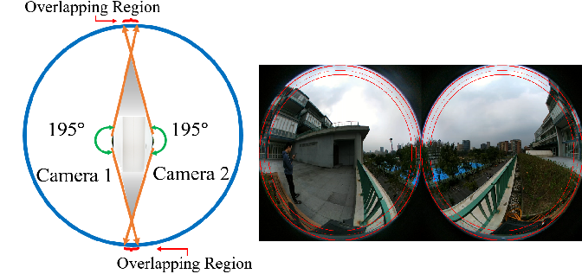
Camera Models
Omni-Directional model
Spherical model
Dual Fish-Eye model
It captures a 360-degree view.
Different projection models are employed to map the entire spherical or cylindrical scene onto a 2D image.
It captures a full spherical view.
Projection models take into account the entire spherical geometry.
Used in some 360-degree cameras.
Capture two fish-eye images and stitch them together for a complete spherical view.

Slide 26
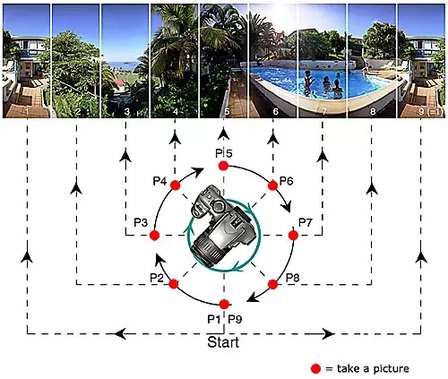
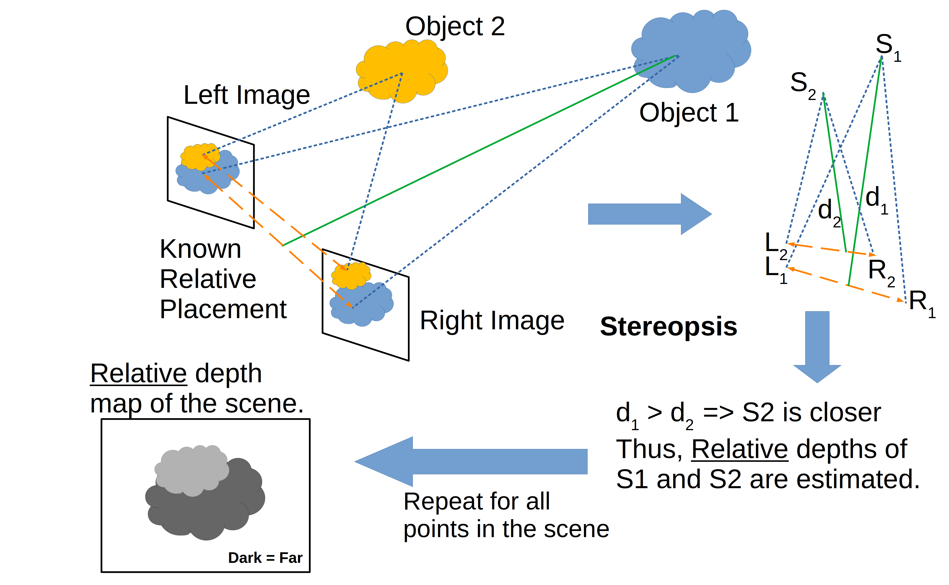
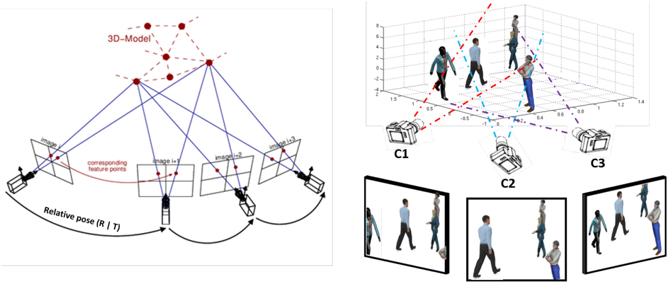
Camera Models
Panoramic model
Multi-View model
Stereo model
It captures a wide horizontal view.
Various projection models are applied to map the scene onto a 2D image.
Applications involving multiple cameras.
Each camera has its own intrinsic (focal) and extrinsic (locational) parameters.
Two or more cameras capture images from slightly different viewpoints.
Employed for depth perception and 3D reconstruction.

Slide 27
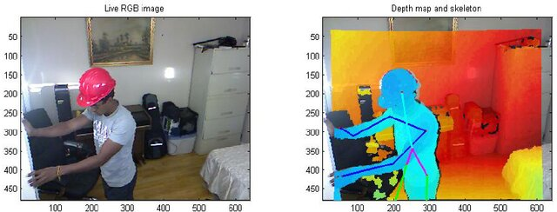
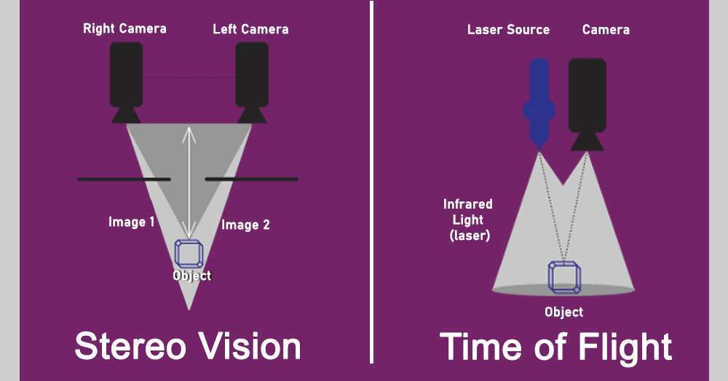
Camera Models
RGB-D Camera Model
Time-of-Flight Camera Model
It provides color information along with depth information.
E.g. Microsoft Kinect camera
It measures the time taken for light to travel from camera to object and back.
This information is used to calculate depth.

Slide 28
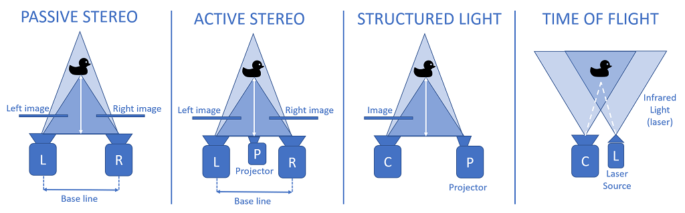
Depth sensors

Slide 29
Steps in Camera Pose Estimation
Feature Extraction:
Identify distinctive features in the images, such as corners or keypoints.
Feature Matching:
Match corresponding features between different images.
Pose Estimation:
Use the correspondences to estimate the camera pose.

Slide 30
Challenges and Applications
Challenges
Applications
Ambiguity:
Limited or repetitive features
Noise:
Noise in image data, inaccuracies in feature matching, or errors in calibration
Augmented Reality
Robotics
3D Reconstruction

